Slide 1
Mechatronic Machine Design (MMD)
Exercise 3
Deadline Jan 31, 2023, 9:00

Slide 2
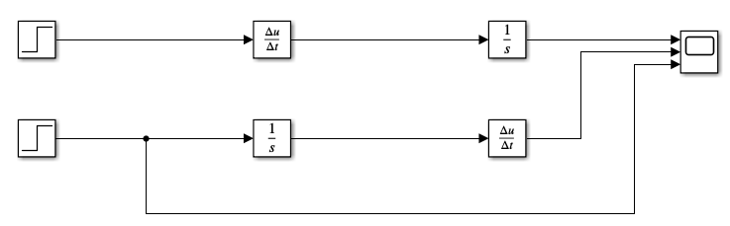
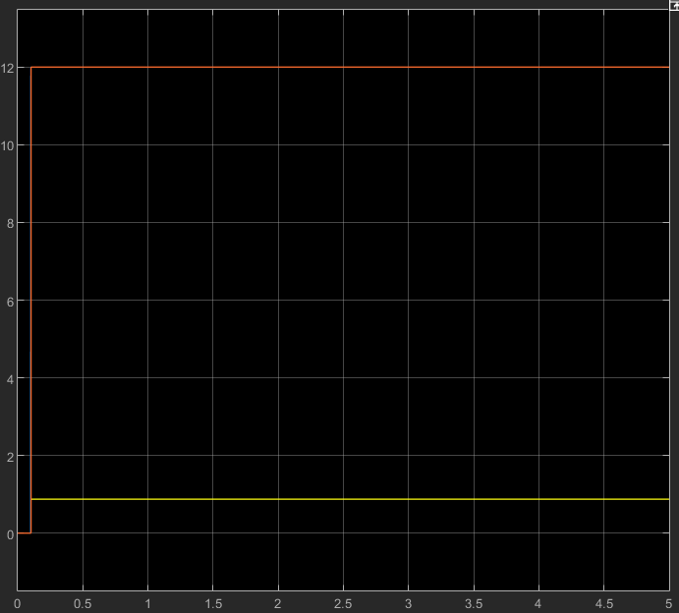
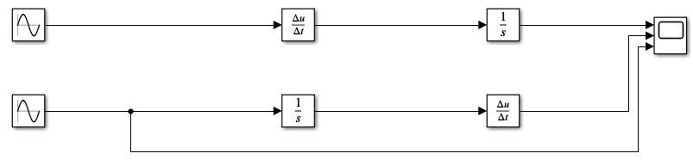
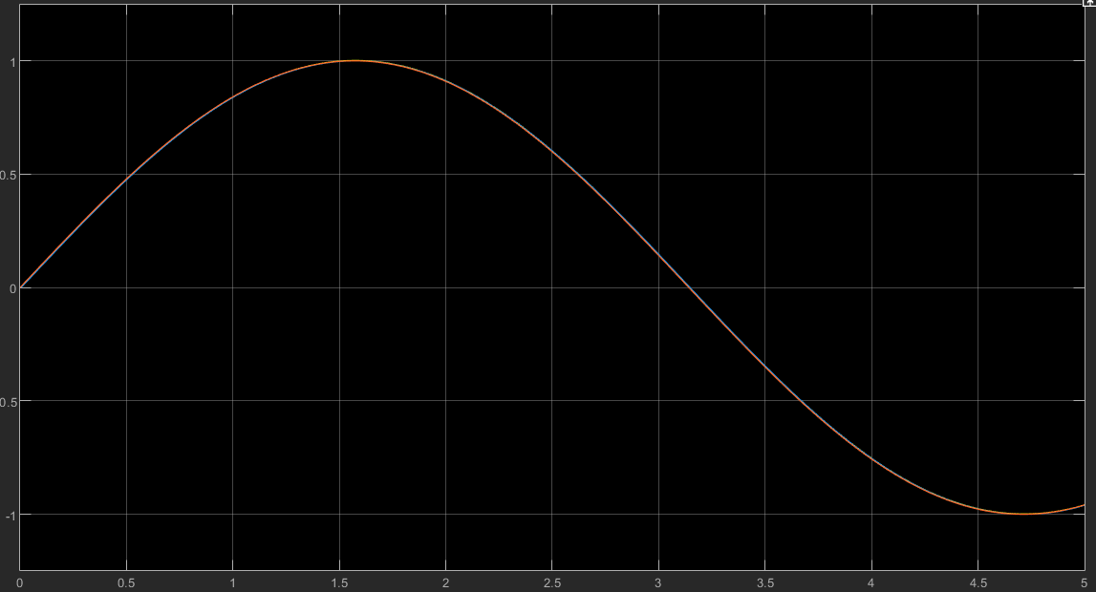
Integral and Derivative Module

Slide 3
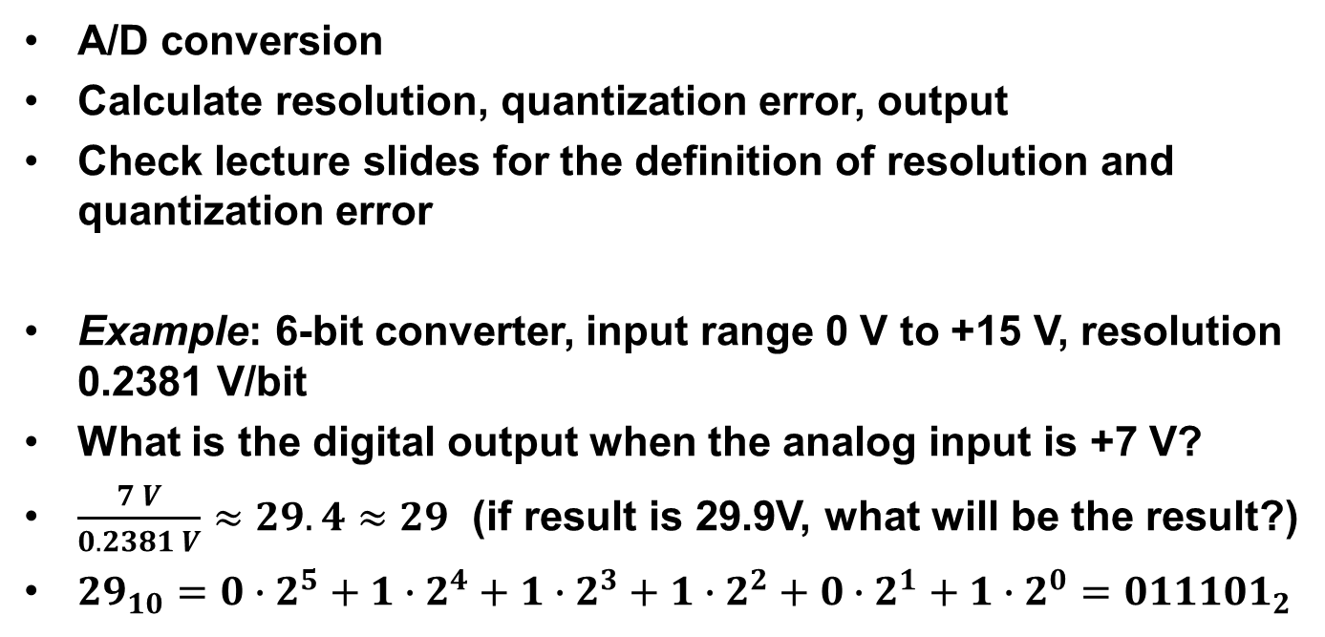
Task 1
A/D conversion
Calculate resolution, quantization error, output
Check lecture slides for the definition of resolution and quantization error
Example: 6-bit converter, input range 0 V to +15 V, resolution 0.2381 V/bit
What is the digital output when the analog input is +7 V?
$\frac{7 V}{0.2381 V}≈29.4≈29$ (if result is 29.9V, what will be the result?)
${29}_{10}=0∙2^{5}+1∙2^{4}+1∙2^{3}+1∙2^{2}+0∙2^{1}+1∙2^{0}={011101}_{2}$

Slide 4
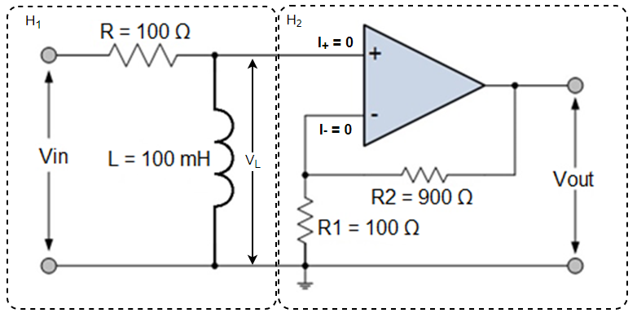

Task 2
High-pass filter
Divide to two transfer
functions H1 and H2
H1 = V_L/V_in, H2 = A_cl
No current thru op-amp
Check A_cl from lecture slides (also see Lecture 2 part 2 for H_1)
$H\left(s\right)=\frac{v_{out}\left(s\right)}{v_{in}\left(s\right)}=\frac{v_{out}}{v_{L}}∙\frac{v_{L}\left(s\right)}{v_{in}\left(s\right)}=A_{cl}∙\frac{v_{L}\left(s\right)}{v_{in}\left(s\right)}=H_{1}∗H_{2}$
The gain at the passband is $A_{cl}$.
-3 dB cut-off frequency is the frequency at which the gain is $1/\sqrt{2}$ times the passband gain, i.e. $\left|H\left(jω\right)\right|=\frac{Passband gain}{\sqrt{2}}$

Slide 5
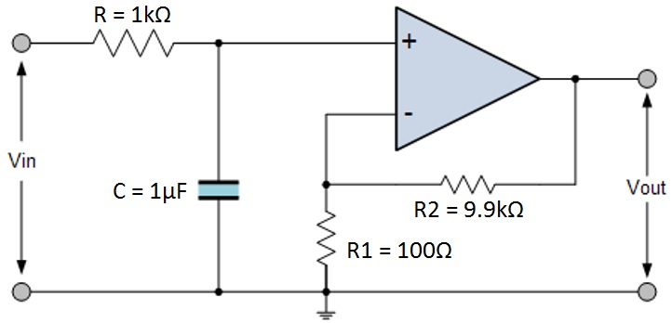
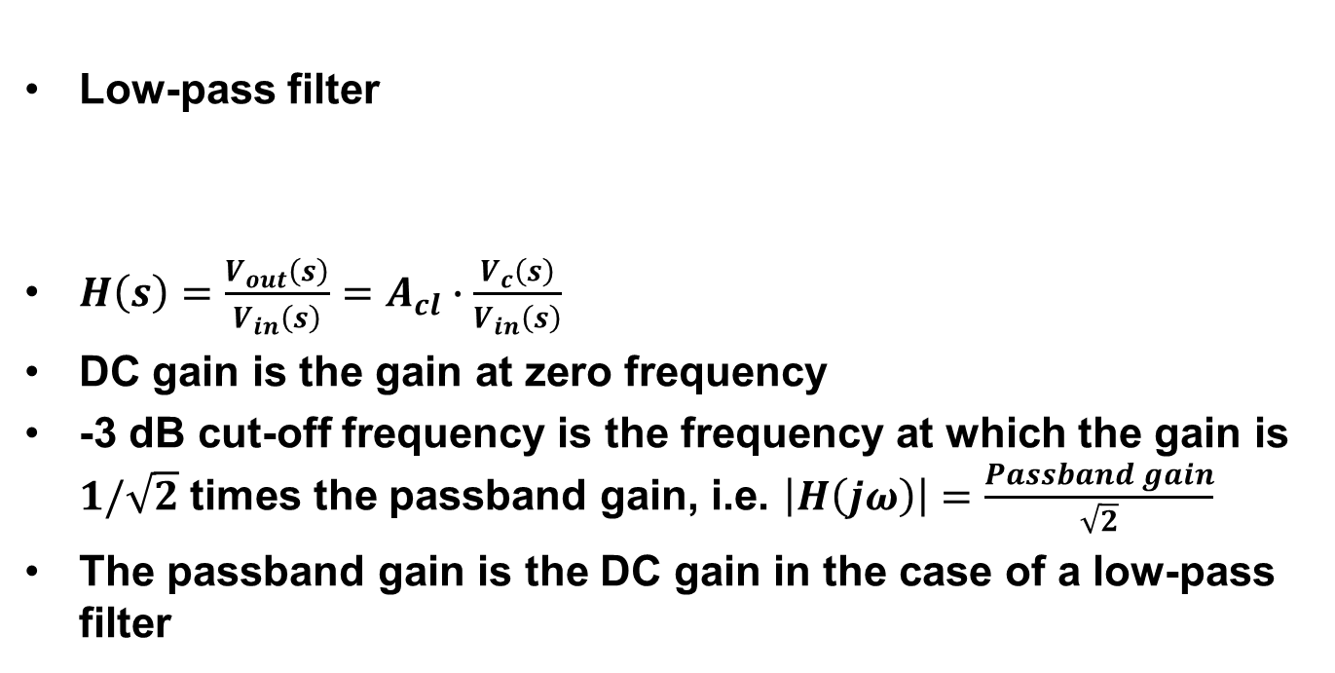
Task 3
Low-pass filter
$H\left(s\right)=\frac{V_{out}\left(s\right)}{V_{in}\left(s\right)}=A_{cl}∙\frac{V_{c}\left(s\right)}{V_{in}\left(s\right)}$
DC gain is the gain at zero frequency
-3 dB cut-off frequency is the frequency at which the gain is $1/\sqrt{2}$ times the passband gain, i.e. $\left|H\left(jω\right)\right|=\frac{Passband gain}{\sqrt{2}}$
The passband gain is the DC gain in the case of a low-pass filter

Slide 6
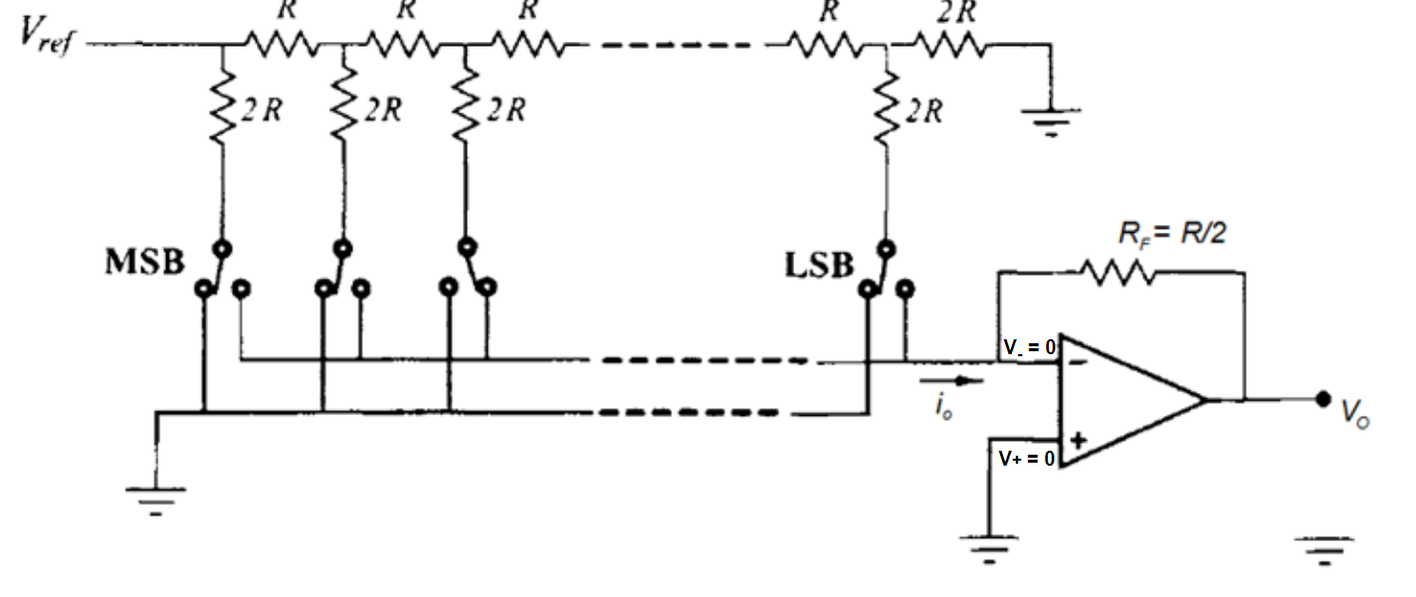
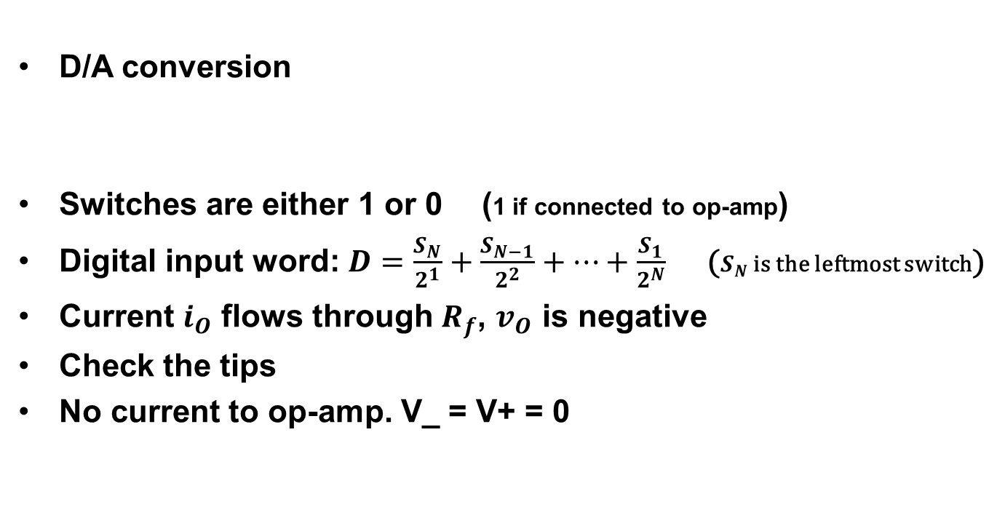
Task 4
D/A conversion
Switches are either 1 or 0 (1 if connected to op-amp)
Digital input word: $D=\frac{S_{N}}{2^{1}}+\frac{S_{N−1}}{2^{2}}+…+\frac{S_{1}}{2^{N}}$ ($S_{N}$ is the leftmost switch)
Current $i_{O}$ flows through $R_{f}$, $v_{O}$ is negative
Check the tips
No current to op-amp. V_ = V+ = 0

